Slide 1
Alfresco Content Services

Slide 2

Alfresco Digital Business Platform –
Content at Core
PROCESS
CONTENT SERVICES
SECURITY
INTEGRATION
CONTENT
FEDERATION
ANALYTICS
GOVERNANCE
SEARCH
AI/ML
INTELLIGENCE
Choice of Deployment
PaaS On Premises Private Cloud
Notes:
So at Alfresco, we have a platform called the Digital Business Platform. The platform really encompasses all of our offerings and at the core of that offering is content. Content services has been fundamental to the growth and establishment of Alfresco. We have a flexible, yet extensible set of services around content that allows customers to build lots of different types of solutions.
The DBP (Digital Business Platform) has several other services, intelligence, analytics, integrations with lines of business applications like salesforce, search, which is one of the key areas we've invested heavily on in the last 5-10 years and really understanding what search means at scale. We try to build our solutions where our customers are and over the last 18 months or so, we've been honing in on the alfresco cloud, which houses our DBP offering. And we are seeing a big push of customers moving to that cloud, but we also support different hybrid options: AWS, Microsoft Azure and obviously a bunch of customers will utilize on-premise installations.
https://www.alfresco.com/platform

Slide 3





Get a competitive edge with Alfresco Content Services
Scale and
Cloud-Native
User Centric
Workplace
Security & Risk
Management
Productivity
Intelligence
Content Centric
Process
Cloud-Native content services platform
Modular approach provides customers a scalable platform
Open Source - No lock-in, greater innovation and fast to integrate and extend
Build Intelligent Business Solutions at Breakthrough Speed
Modern, simple user experience customers demand
Integrated into common business apps and processes
Invisible & automated Governance
Govern-In-Place: extend compliance to existing systems
Security classification & Marks allows for incredibly granular control
Auditability and Business Reporting
Insight Engine to content analytics
Visualization with Modern Business Intelligence Tools
Automate Content Centric Processes in the Cloud
Rich set of OOTB content-centric connectors for instant integration
Low code process and application design
Notes:
Two key solutions I want to call out today are governance and process.
Governance really helps customers mitigate risks when managing their information lifecycle. That is everything from understanding who is accessing content and how long the content will last in the system. We have customers who want to retain their information for 10's, not even 100's of years.
Process or really workflow, on top of content helps us really unlock business value. Process is key to understanding how customers build applications, which type of use cases they want to build, and also how they form collaboration with their customers or within their internal employees.
Given our role, I am sure you'll be more interested in Governance.
Open includes being Open source of course, but also providing OPEN API’s and an open, modular architecture which means we are easy to integrate and extend. This is critical because content doesn’t sit in isolation and needs to be integrated with other systems- some that can be achieved with Alfresco with a level of AGILITY and flexibility completely missing from legacy ECM systems.
Access- To accelerate employee productivity, it is vital that users can access the right information at the right time. Companies need the flexibility to offer access to content WITHIN systems be used to get work done, like Salesforce, via the web, on the go and offline with mobile apps or desktop sync. On top of this, though our ADF, companies can deliver quickly deliver the bespoke apps that are increasingly demanded- which all ads up to better user-driven experience and user adoption
Process!- We have a built not acquired portfolio and ‘exploiting’ content needs process. A key part of our platform argument (and what changes with content services ) is to NOT look at ECM in isolation- but in combination with people, process.
Governance- Alfresco provides a breakthrough level of simplify for information governance and compliance. Legacy systems are certainly full featured, but totally fail on user adoption = which equals compliance risk. We automate so compliance just happens, while legacy vendors are stuck trying to ‘educate’ users on how they should use these unintuitive systems. Combined with our ability to deliver compliance across content and processes seamlessly, we offer customers a way to actually reduce compliance risk.
Scale/performance- While legacy ECM do in deed scale, the associated costs are huge and growing. Alfresco makes it really easy for our customers to take advantage of standard cloud services like AWS for much lower total cost of ownership as well as better time to value. We can even have you up and running with a high availability, best practises instance of Alfresco in just 45 mins.

Slide 4







Alfresco Governance Services
Records Management
Information Lifecycle Management
Security & Controlled Access
Regulatory Compliance
eDiscovery and Legal Holds
Content Federation and Manage In Place
Notes:
Government is really interesting for Alfresco, we've had a really strong set of use cases for building solutions for government agencies. We look at how we can extend our use cases through our partner ecosystem to really broaden our market reach and this has been one of the most successful things as we build up solutions with those partners. We've been able to attack use cases such as customer onboarding, incident management, contract management with many partners.

Slide 5

What’s new in ACS
Scale & Performance
Elasticsearch
New Query Sets improve linear database scalability
Optimization around Read / Write / Ingestion
Early Access for Elasticsearch
General Availability in Summer 2021
Compliance & Security
Deployment & Customizations
auto detection and tagging of Personal Identifiable Information (PII)
Simplified deployment options
New Alfresco Event SDK
Alfresco Extension Inspector
Alfresco Content Services provides significant improvements in Scalability, Performance, Security, Risk Management and delivers the most open, cloud-native content services platform to accelerate business transformation.

Slide 6
Capabilities

Slide 7

Deployment choice
Driving agility, scale and innovation through the cloud

Slide 8

Customer
Benefit
On-Prem
Amazon Web Services (AWS)
Fully supported for organizations that prefer deployments in local datacenters - including Docker & Kubernetes for standardized and fast deployments across all environments
Alfresco is the only modern platform that is fully optimized for AWS Virtual Private Cloud (VPC) deployment
Alfresco Cloud
Microsoft Azure
Deploy and run process and content-intensive apps in a fully managed and hosted PaaS environment
Leverage the Microsoft cloud as one of the leading cloud storage services
Driving agility, scale and innovation on-prem or through the cloud
Modern User Interfaces to improve end user adoption
Enterprise class repository to manage and govern content
Certified integrations into major LOB apps
Broad partner network with additional integrations

Slide 9
Cloud Integrations

Slide 10
Alfresco Cloud integrations
Cloud Storage
Cloud Office Suites
Leverage AWS S3, AWS S3 Glacier or Azure Cloud Storage to store business information in the leading cloud storage solutions
Native integrations into Microsoft 365 and Google Docs for real-time collaboration and co-authoring
AI & ML
Productivity Suites
Automatically enrich content and gain valuable insights by leveraging AI and ML services from AWS
Knowledge workers rely on productivity suites like Slack, Teams or Zoom
Platform Benefits
Customers can easily leverage cloud services that are tightly integrated in the Alfresco Digital Business Platform

Slide 11



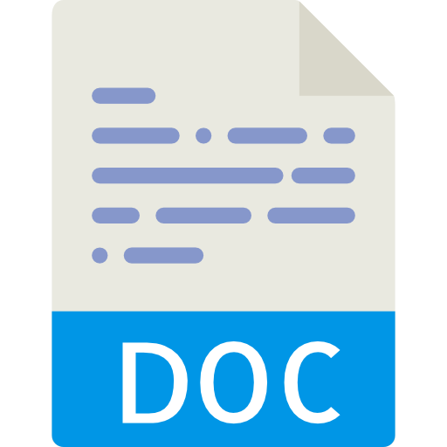

Alfresco Intelligence Services
Content + Governance Apps
Amazon Web Services (AWS)
Format Rendition
(PDF, PNG, etc.)
Content Services
AI Rendition
Can be re-processed
Amazon
Comprehend
Amazon
Rekognition
Amazon
Textract
Governance
Transformation
Router
Identity
Search
imagemagick
Comprehend
libreoffice
Rekognition
Files
Meta
data
pdf-renderer
Textract
tika
Other…
Notes:
Opening narrative:
Problem-solution
Document transformations are used heavily within ACS and APS, and all content added into ACS generates thumbnails, text versions, and other renditions for previews. In ACS, the rate of transformations has been a rate-limiting factor when ingesting huge quantities of files for example during a migration, this can result in transformations being disabled during a large data migration in order to achieve a reasonable throughput.
The current Transform service that is embedded in ACS cannot successfully support customers who are migrating to Alfresco at scale, or have large ingestion use-cases because the service can not be independently scaled.
Value to customers:
approach-Outcome
Extract transformations into a common service across content and process. The Transform Service provides a scalable, secure, reliable, and extensible mechanism for converting files from their current format into other formats.
Key highlights include:
ability to scale the transformation capabilities independently of the content repository
ability for all subsystems of the platform to make use of the exposed transformation capabilities
a greater level of reliability and fault tolerance

Slide 12
Customer
Benefits of
Alfresco
AI and ML
No AI / ML experience needed
Extract data quickly & accurately
Intelligent categorization at scale
Eliminate manual effort & Lower processing costs
Identify sensitive information
Drive Digital Transformation
Customer
Benefits of
Alfresco
AI and ML

Slide 13
Integrations

Slide 14
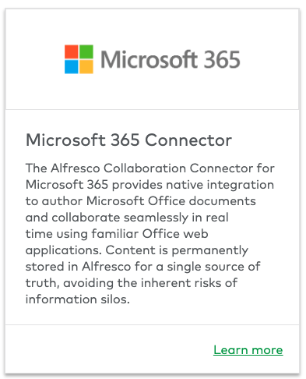
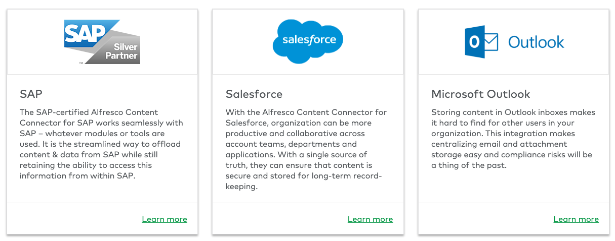
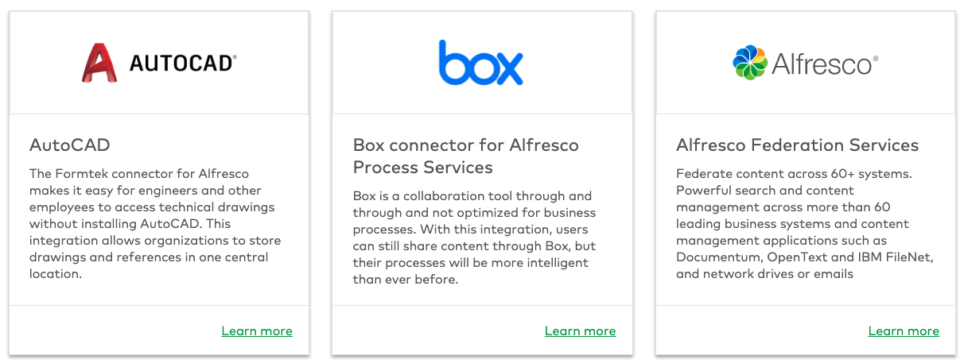
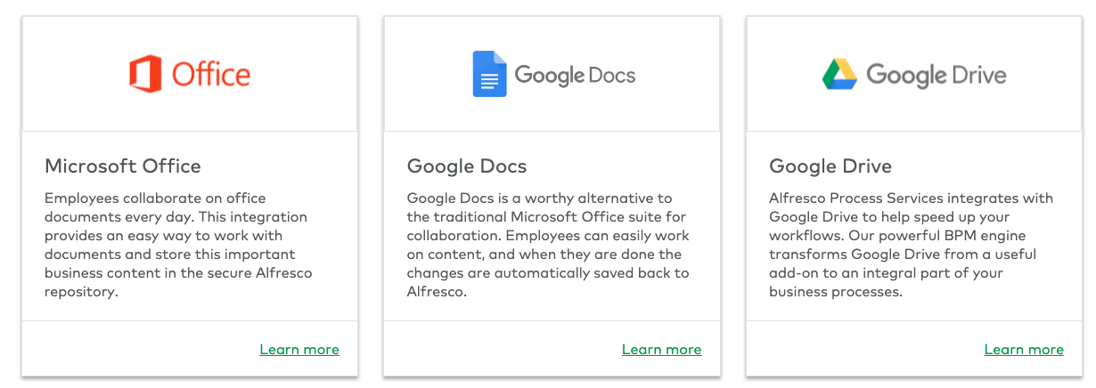
Alfresco Integrations
Notes:
Employees everywhere find themselves having to switch between applications to perform routine tasks and access basic information. Stop the madness. Let them access critical content using their preferred business applications, manage content in the background, and enable content services with the modular and open Alfresco Digital Business Platform that integrates seamlessly with many popular end user and line of business applications out of the box.

Slide 15
Questions?

