Slide 2
Nuxeo Overview
A Cloud-native Content Services Platform
Presenter Name
Presenter Title

Slide 3

What is Nuxeo?
Notes:
Give photo options

Slide 4
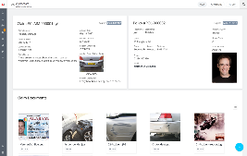









Supporting a broad range of use cases
Providing broad extensibility
Web UI
Nuxeo
Drive
Content-Enabled Applications
Digital Asset Management
Document Management
Case Management
Knowledge Management
3rd Party Business Apps
3rd Party Productivity Apps
Productized Apps
Configured/Custom Apps
Nuxeo Content Services Platform
Content & Process Analytics
Content Delivery
Metadata Enrichment
Case & Process Management
Services
Connector
Archiving
Retention Management
Artificial Intelligence
Capture & Recognition
Rendering & Transformation
Enrichment
Conversion & Transformation
Security & Audit
Query & Search
Ingestion
Nuxeo Unified Data & Content Model
Data & File Storage Options
SQL/NoSQL DB
Cloud Storage
EFSS
Legacy Systems
Cloud
Hybrid
On-Premises

Slide 5

Truly unique platform approach
Data +
Content
One platform for all of your data or content management needs
Maximum
Performance
Leading-edge technologies ensure maximum performance & scalability
Cloud-Native
Architecture
Deploy anywhere with all the advantages of a native cloud solution
Continuous
Innovation
No release dates. New features & functionality are immediately available
Low-code,
Not No Code
Simple enough to build
apps in weeks; powerful enough for even the most complex business solutions
Business-
Specific AI
Greater insight through custom models trained for your unique business
Notes:
Manuel

Slide 6
Architecture

Slide 7

Independently and Intelligently Scalable
Scale out, no single point of failure… Segment Nuxeo nodes for specialized processing
Nuxeo Server
Interactive Processing
OpenSearch*
*Elasticsearch also supported
Search
Nuxeo Server
Async. Processing
Database
MongoDB
PostgreSQL
Oracle
Data Storage
Kafka
Binary Storage
File System
Amazon S3
Azure Blob
EFSS
GridFS
Job Queues
Distributed Cache
File Storage

Slide 8
Nuxeo Logical Architecture
Nuxeo Platform
Storage
Nuxeo Server
OpenSearch*
(indexes)
*Elasticsearch also supported
Nuxeo Server
Elastic Load
Balancer
Database
(data / metadata)
Shared State
Kafka
(cache)
Blob Store
(files)

Slide 9





Nuxeo Cloud Architecture
Nuxeo Platform
Storage
Nuxeo Server
c4.xlarge
4 xCPU, 7.5 GB, 100 GB EBS
OpenSearch
3 x C4.2xlarge
8 vCPU, 15 GB, 250 GB EBS
Other AWS services leveraged
by the Nuxeo Platform:
Nuxeo Server
Elastic Load
Balancer
MongoDB Atlas
Amazon CloudFront
AWS/Elastic Auto Scaling
AWS Lambda
Amazon Elastic Transcoder
Amazon Rekognition
NOTE: Sizing is for example purposes only.
c4.xlarge
4 xCPU, 7.5 GB, 100 GB EBS
Shared State
RDS
db.e3.xlarge PostgreSQL
4 vCPU, 30.5 GB, 100 GB
ElastiCache
3 x cache.m2.xlarge
2 vCPU, 16.7 GB
S3
20 TB Standard Storage

Slide 10
Configurability
& Extensibility

Slide 11
Nuxeo Component Model
The Nuxeo Platform is based on a configurable and extendable component model:
One component model for all layers of the platform
Everything is a component
Everything is configurable
Configuration is a software artifact
All components are reusable
Based on OSGi specification for Java
Component C1
Service S1
Manifest
Extension Point 1
Extension Point 2
Java
Bundle B1
(jar file)
Component C2
Manifest
Code Contribution
Java
Bundle B2
(jar file)
Development
Component C3
Manifest
Configuration contribution
XML
Bundle B3
(jar file)
Component C1
Service S1
Extension Point 1
Configuration contribution
Extension Point 2
Code Contribution
Java

Slide 12

Configurable
data model
Relate assets to any business objects or data elements crucial to your enterprise.
ASSETS ALIGN TO YOUR BUSINESS ACTIVITIES.
Relate assets to each other: derivatives, translations, variants…
Audiences
Campaigns
Customers
Projects
Transactions
Products
Markets
Photo Shoots
Analytic Objects
Content Groups
Deals
Talent rights
Inquiries
Business Categories
Social Posts
Web Metrics
Product Categories
Stores
Characters
Dealers
Locations
Franchises
Games
Notes:
Content Grouping: Content grouped by the processes and workflows that teams work within
Business Categorization: Foundational organizational structure of your business that systems align with
Analytic Objects: Data objects from other systems that content can be analyzed against
NOTE: ask Uri and Dave for ideas for the biz objects critical for analytics like content effectiveness – need to compare assets/content against? transactions, deal size, time on site, engagement metrics? – but more the biz objects which contain that data – is it sessions, customer metrics, engagement event or what? Tried to so

Slide 13
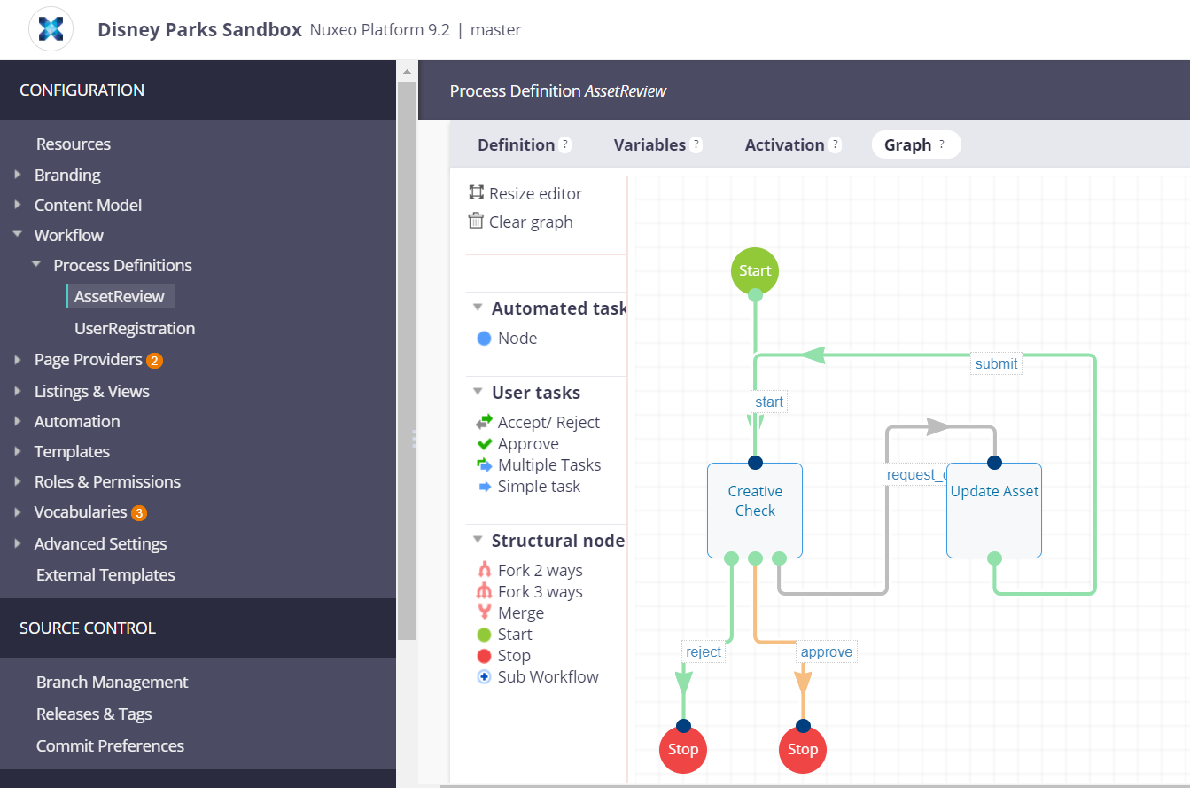
Configuration with Nuxeo Studio
Nuxeo SaaS service
Nuxeo Studio Modeler
  Clicks, not code
Nuxeo Studio Designer
  WYSIWYG editor
W3C standards
  Web components
  HTML/CSS/JS
Configuration management
  Branches, releases, tags
Notes:
Nuxeo studio is:
A visual tool to configure Nuxeo Platform based applications
Available as an online service (SaaS)
A delivery and deployment channel through Nuxeo Update Center
With Nuxeo studio you can:
Configure and adapt your application
From document typology to business rules enforcement
Without needing development work
Save time and money, by focusing on your business needs
Ensure long-term maintenance of your application thanks to the target platform deployment option. Nuxeo guarantees that customization made with Studio will be compatible with next versions of Nuxeo.

Slide 14
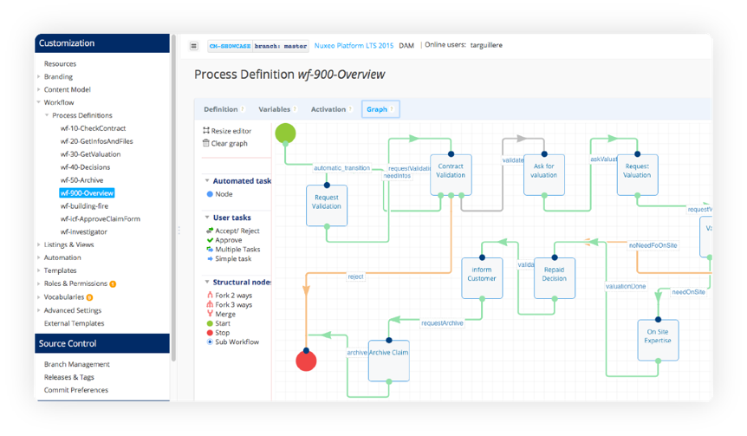
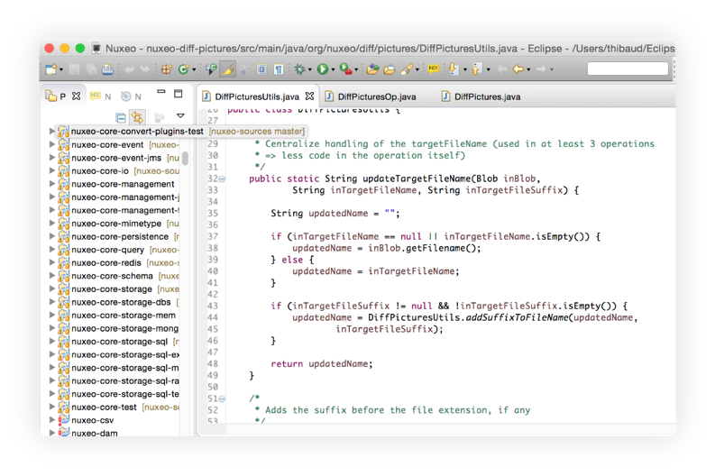
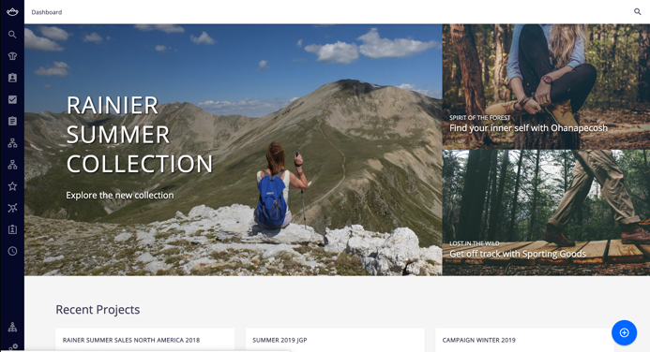
Configuration + Customization
Nuxeo Studio
Nuxeo-cli and Eclipse/IntelliJ
Your Application

Slide 15
Storage Principles

Slide 16
Storage Principles
Document
Data (fields)
title
Description
• • •
Blob
Nuxeo Server
DocumentStore
BlobStore
Index
Audit
Database
Blob Storage

Slide 17
Storage Principles
Document
Data (fields)
title
Description
• • •
Blob
DocumentStore is
pluggable
Nuxeo Server
DocumentStore
BlobStore
Index
Audit
Database
Blob Storage

Slide 18
Storage Principles
Document
Data (fields)
title
Description
• • •
Blob
Nuxeo Server
Index/Audit is
pluggable
DocumentStore
BlobStore
Index
Audit
Database
Blob Storage

Slide 19
Storage Principles
Document
Data (fields)
title
Description
• • •
Blob
Nuxeo Server
DocumentStore
BlobStore
BlobStore is
Hybrid
Index
Audit
File System
Database

Slide 20
Security

Slide 21
Web UI
API
Security
Authentication
Support major authentication protocols and systems
Support common directory and identity services
Pluggable
Permissions
Always Active
Based on Access Control Lists
Access can be temporary
Pluggable
Authentication Filter
+Authentication
Plugins
Login Module
User Manager
LDAP. SQL, …
+ Custom
Source
Security
Context
Users
Groups
Security Service
ACL Checks
+ Custom
Policy
Security Policy
Repository

Slide 22
Performance

Slide 23
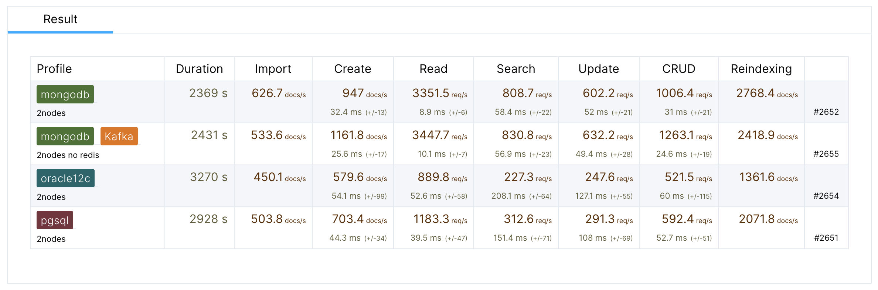
Benchmarks
  https://benchmarks.nuxeo.com
  username: benchmarks
  password: p@ssw0rD

Slide 24
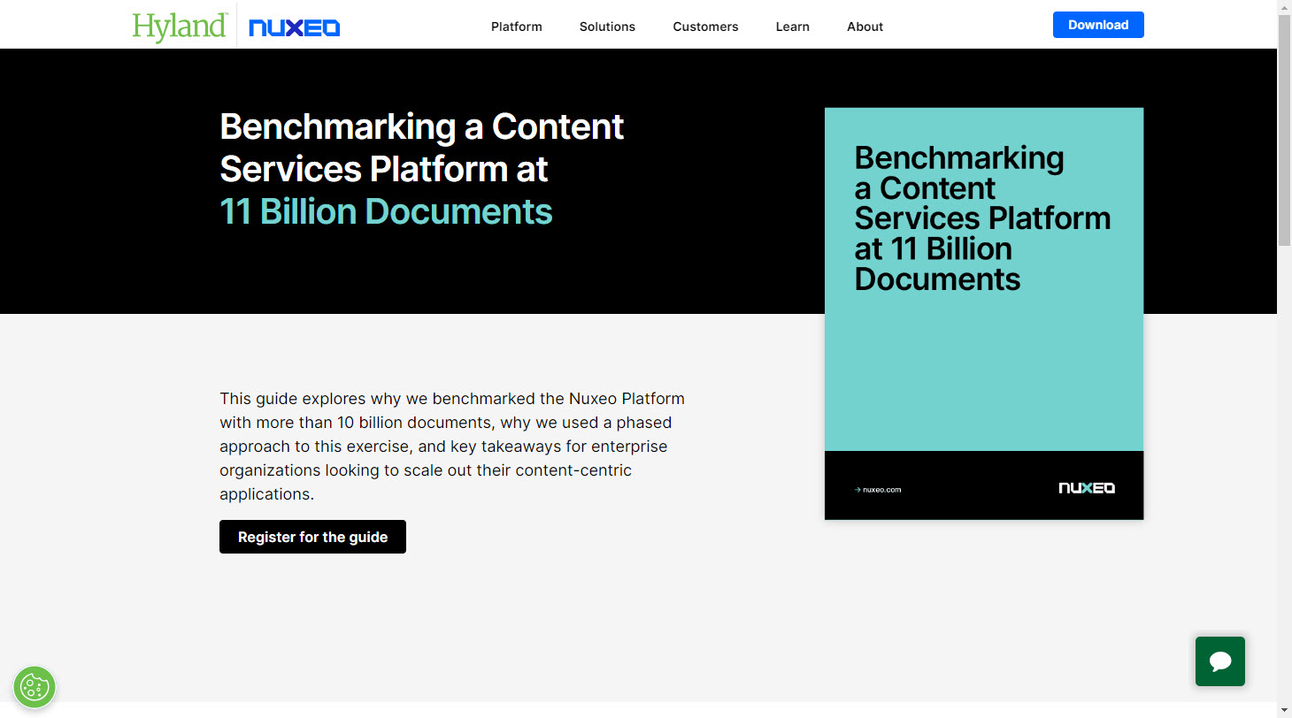
11 BILLION DOCUMENT BENCHMARK
https://benchmarks.nuxeo.com/11-billion-benchmark-story/
Download the report here:
https://www.nuxeo.com/resources/benchmarks-11b/

Slide 25
11 Billion Asset
Benchmark Exercise
2,700
concurrent users
11 Billion
assets
25K / sec
bulk import
1,900 / sec
requests
< 220 ms
p95 response time

