Slide 1
OnBase
An Introduction to the OnBase Content Services Platform

Slide 2







BEST-OF-BREED CONTENT SERVICES
Notes:
First, let’s take a look at the full range of our Content Services capabilities

Slide 3













Search
Reporting and analytics
Collaboration
Retention and records management
Customer communication management
Hyland RPA
Case management
Nuxeo DAM
CORE CAPABILITIES
ENHANCED CAPABILITIES
Process automation
Governance Rules as a Service
Content management
Document Composition
OnBase
OnBase
Multichannel capture
Enterprise Search
PACKAGED SOLUTIONS
INTEGRATIONS
EXTENSIBILITY
SECURITY AND COMPLIANCE
Healthcare
Insurance
Education
Government
Financial services
Manufacturing
Departmental
and more
Enterprise applications
Line of business solutions
Productivity applications
Custom
Low code platform
Web services
Integration servers
API
Legal holds
Vital records
Group policies
Redaction
Defensible destruction
External auditor access
Encryption
Redundant configurations
Notes:
Module Alignment:
Core Capabilities
Multichannel Capture: OnBase Capture, Advanced Capture
Capture all types of content with intelligent automation to classify, extract and validate critical incoming information
Content Management:
Organize, manage and optimize content across your organization and provide users with a complete view of the information
Process Automation: Workflow
Intelligently automate tasks, route documents, manage exceptions and enhance key processes
Case Management: WorkView
Low code development and management of data, tasks, activities, correspondence and events surrounding unstructured cases and knowledge-driven processes
Customer Communication Management: Document Composition
Automate the process of creating and distributing customer-facing documentation
Collaboration:
Securely share content, collaborate on documents and extend related processes to those inside and outside your organization
Search: Full Text Search
Intelligently find the right information across numerous systems, applications and devices
Reporting and Analytics
Gain visibility into content and processes with actionable insights
Retention and Records Management: Records manager, Retention Policy Manager
Automate secure retention and destruction of documents and records
Enhanced Capabilities
Hyland RPA
Automate manual, rule-based, and repetitive tasks where human touch does not add business value
Nuxeo DAM
Manage, access, and use all your rich media and digital assets with Nuxeo’s enterprise Digital Asset Management capabilities.
Governance Rules as a Service
Hyland has partnered with Iron Mountain® to create the Governance Rules as a Service (GRaaS) solution
Content Composer
Create and manage personalized communications, as well as omni-channel delivery, to help organizations increase engagement with external parties
Enterprise Search
Locate key information regardless of where it exists — content repositories, SharePoint sites, email systems, network shares, intranets, extranets, websites, databases, social media platforms and more.

Slide 4
ONBASE CORE CAPABILITIES
Notes:
Let’s now take a more-detailed look at our Content Services capabilities

Slide 5

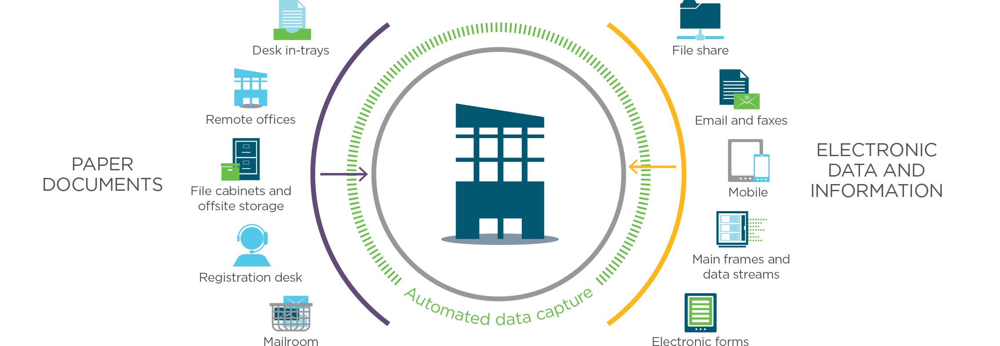
CAPTURE
Capture all types of content with intelligent automation to classify, extract and validate critical incoming information
Notes:
The goal of capture is to Capture all critical content as early in the process as possible, with minimal manual data entry.

Slide 6

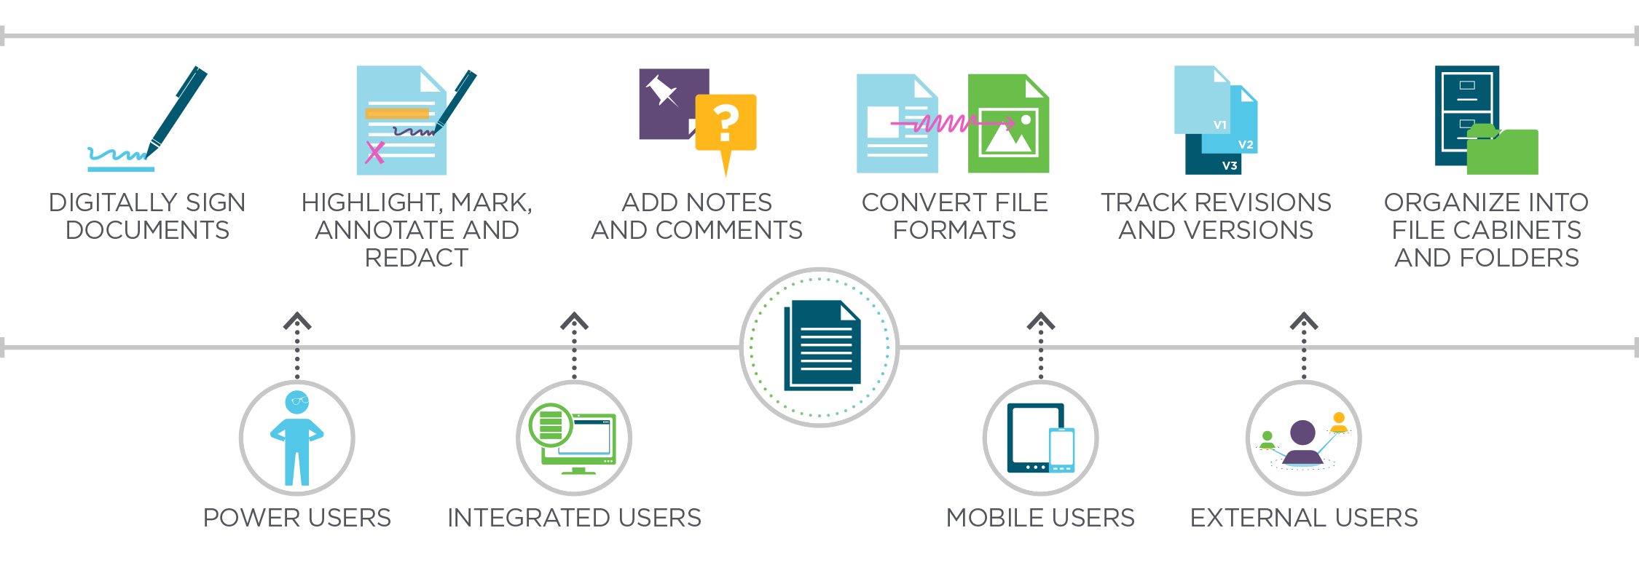
CONTENT MANAGEMENT
Organize, manage and optimize content across your organization and provide users with a complete view of the information
Notes:
The goal of Content Management is to Equip users with all the tools they require to digitally interact with documents.

Slide 7

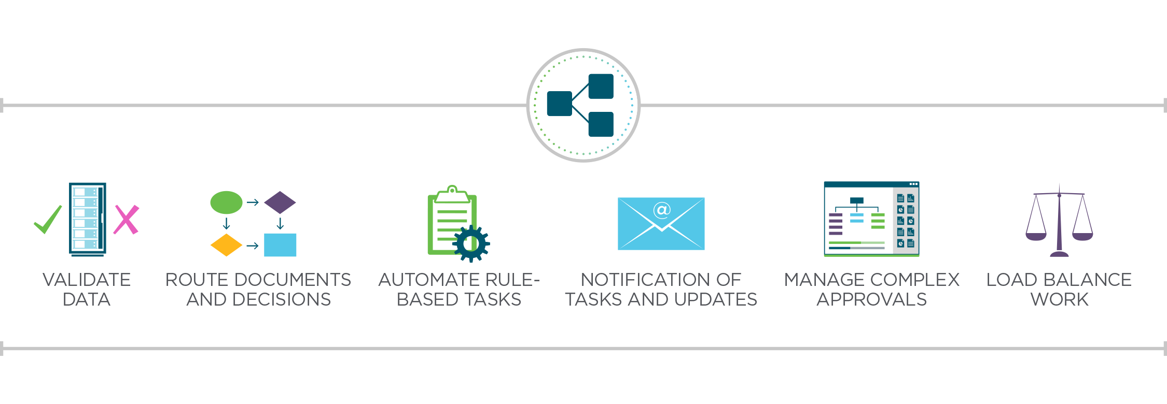
PROCESS AUTOMATION
Intelligently automate tasks, route documents, manage exceptions and enhance key processes
Notes:
The goal of Process Automation is to Add document-specific workflows to the most important content.

Slide 8

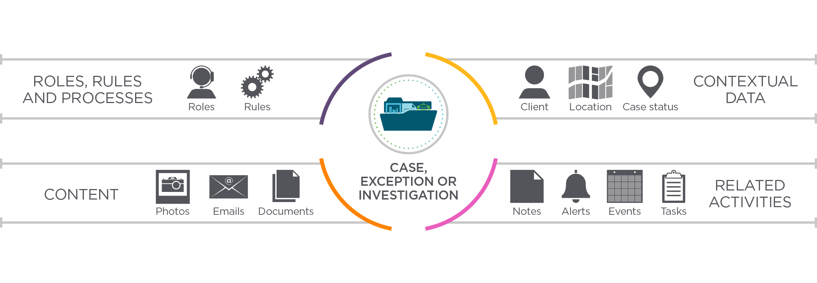
CASE MANAGEMENT
Manage data, tasks, activities, correspondence and events surrounding unstructured cases and knowledge-driven processes
Notes:
The goal of Case Management is to Manage all the data associated with tasks, activities, conversations and reminders alongside content and processes.

Slide 9

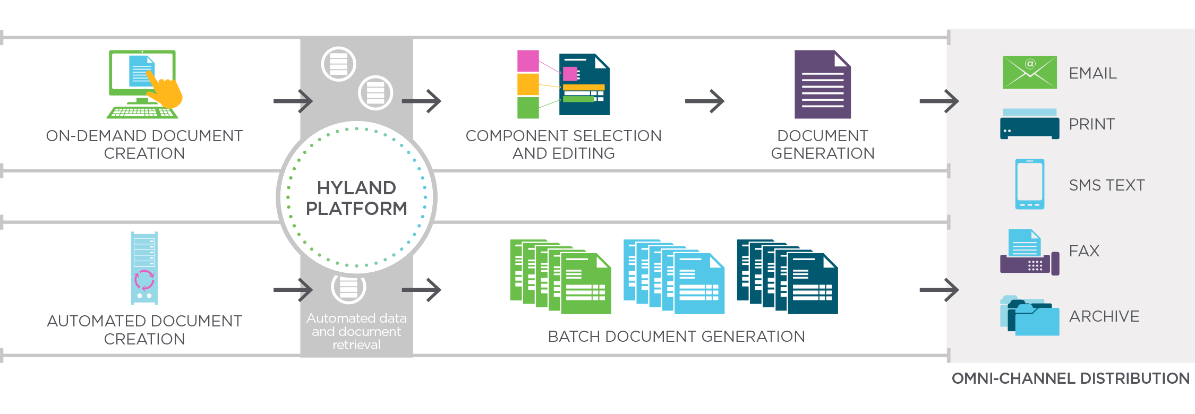
CUSTOMER COMMUNICATIONS MANAGEMENT
Automate the process of creating and distributing customer-facing documentation
Notes:
The goal of CCM is to Automate the generation and distribution of customer communications wherever possible.

Slide 10

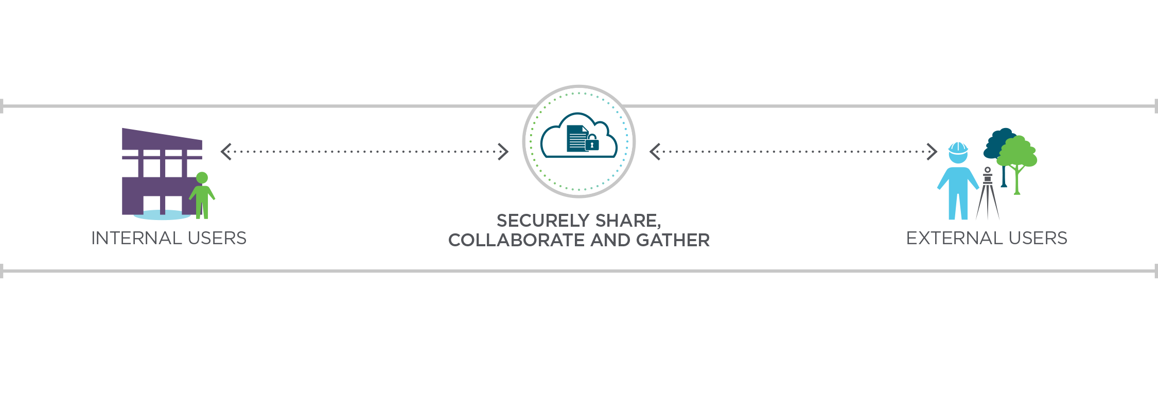
COLLABORATION
Securely share content, collaborate on documents and extend related processes to those inside and outside your organization
Notes:
The key to Collaboration is to Provide the sharing and collaboration tools that users need without sacrificing control and security

Slide 11

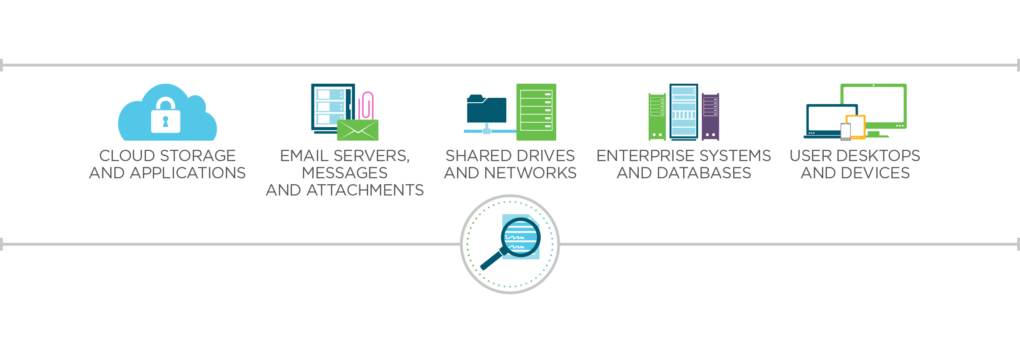
SEARCH
Intelligently find the right information across numerous systems, applications and devices
Notes:
The goal of Search is to provide the ability to quickly find very specific information from information stored in all locations – not just the core systems.

Slide 12

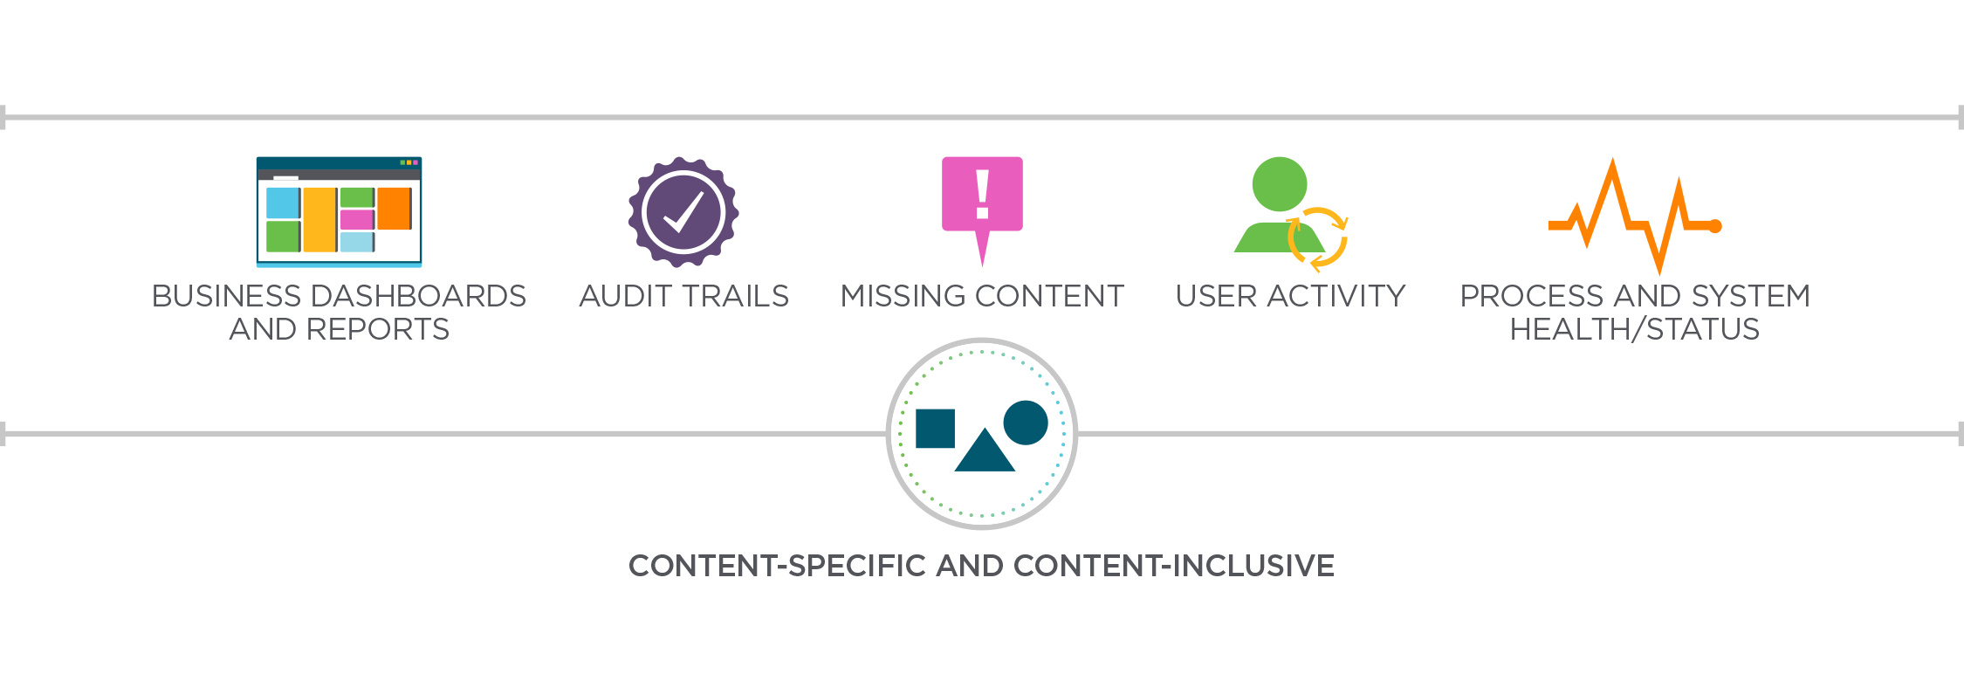
REPORTING AND ANALYTICS
Gain visibility into content and processes with actionable insights
Notes:
The goal of Reporting and Analytics is to provide users the right dashboards, logs and reports so they have accurate knowledge of the status of processes, cases, user activity and overall system health.

Slide 13

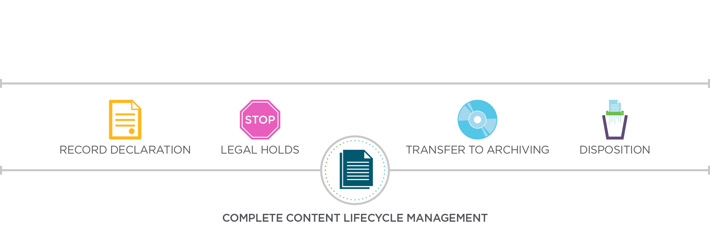
RETENTION AND RECORDS MANAGEMENT
Automate secure retention and destruction of documents and records
Notes:
The goal of Retention and Records management is to automate the implementation of retention periods to ensure that content is being preserved and will be destroyed according to published requirements.

Slide 14



TAILORED INDUSTRY SOLUTIONS

Slide 15




Health information management
Clinical and medical imaging
Enterprise imaging
Revenue cycle
Health insurance
Admissions
Financial aid
Transcript processing
Student affairs
Registrar's office
Property and casualty
Life, health and annuity
Third party administrators
Justice and public safety
Health and human services
Planning and public works
Finance and administration
Banking
Wealth management
Credit unions
Lending
EDUCATION
INSURANCE
HEALTHCARE
GOVERNMENT
FINANCIAL
TAILORED SOLUTIONS AND INDUSTRY EXPERTISE
OTHER INDUSTRIES
ACCOUNTING
HUMAN RESOURCES
TRANSPORTATION AND LOGISTICS
Manufacturing
Retail
Food and beverage
Global trade
Construction
and more
Approval management
Dispute resolution
Invoice capture
Invoice processing
Vendor management
Employee file management
Employee onboarding
Employee relations
Employee offboarding
Policies and procedures
Employee file governance
Freight payment and billing
Freight contract management
Customs clearance activities
Import/export compliance
Notes:
Hyland’s vertical focus enables us to create of expertly tailored solutions. Be sure to explore other solutions that may be available for your industry.

Slide 16
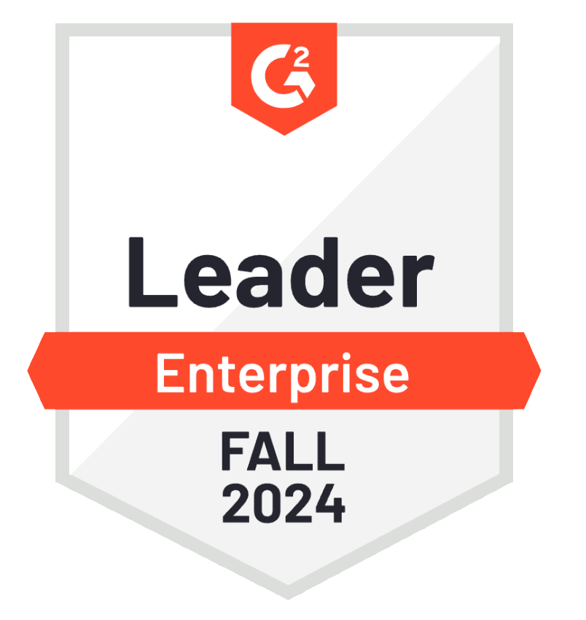
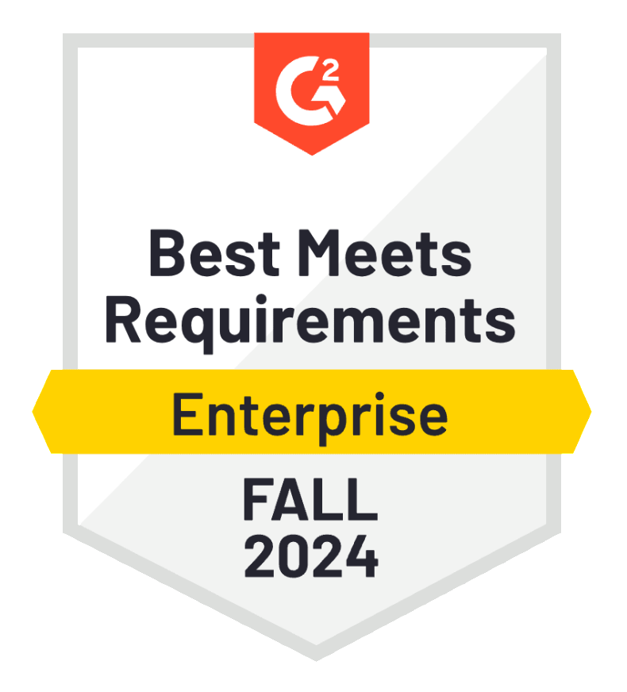
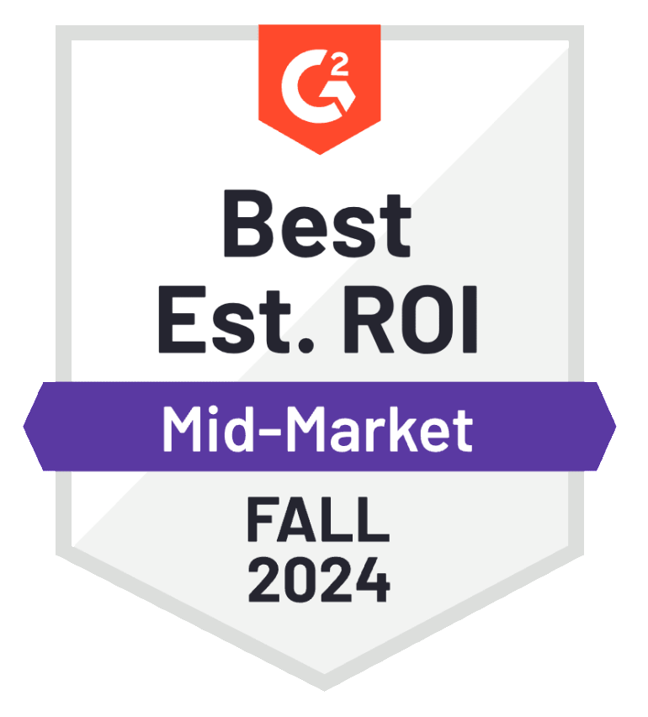
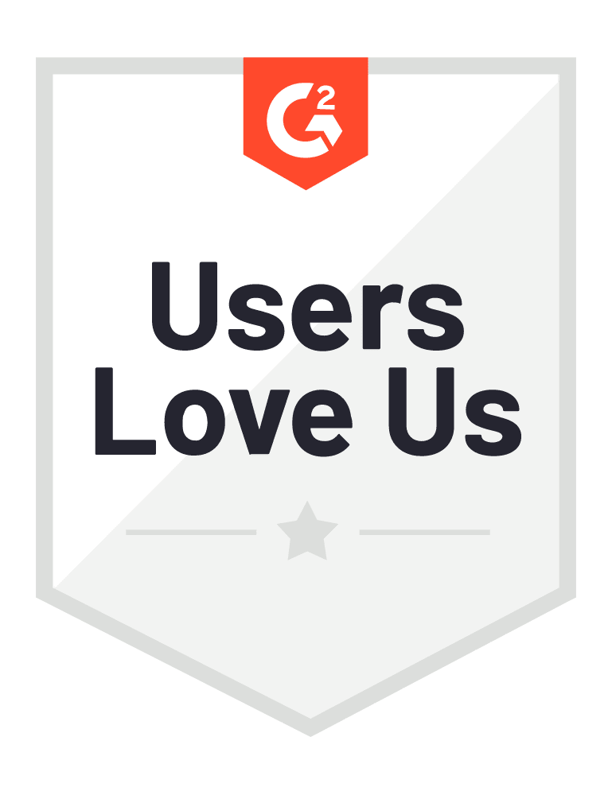
OnBase
G2 Peer
Review Awards
HR SERVICE DELIVERY
Leader - Enterprise Leader
AP AUTOMATION
Best Meets Requirements
ENTERPRISE CONTENT MANAGEMENT
Best Estimated ROI
Notes:
These reviews come directly from our customers, based on the positive experiences they have, which is why we maintain leadership ahead of our competitors in the content services space.

Slide 17
The End

