Slide 1
Contract Management
Point Application Overview

Slide 2
The Flavors of CM
A Live Look at the App
Lessons Learned

Slide 3
The Flavors of
Contract Management

Slide 4
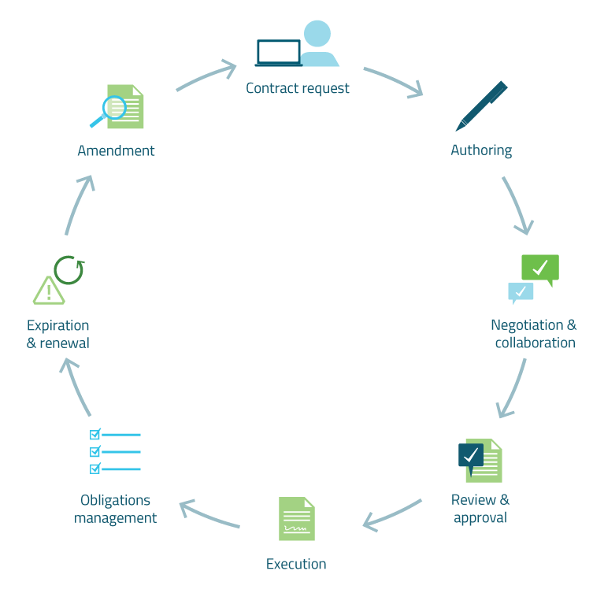
The Contract Lifecycle
Notes:
While there is no universally accepted model for the contract lifecycle - based on our experience there are common process steps that we’ve seen amongst contract solutions. OnBase can provide value within each of these steps.
Request – formally requesting that a contract is created or reviewed by legal

Slide 5


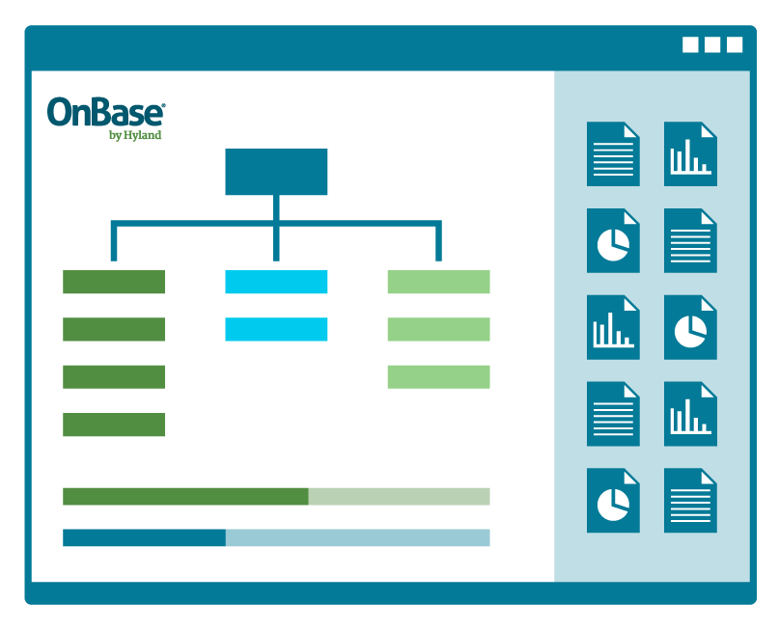
1
2
3
Simple
Simple Process
Complex Process
Document-Driven
Workflow-Centric
Full Lifecycle Management

Slide 6
How’s this differ from other options?

Slide 7
The Classic Approach: Workflow and Forms
Step 1
Start
Step 2
Step 3
Step 4
Step 5
End
Step 6
Step 7
Step 8

Slide 8
The Modern Approach: Case Management
Internal Review
Waiting on Answer
New
Closed
External Review
Paused

Slide 9
This is the Solution Spectrum

Slide 10
Built from Scratch
Full Consulting Engagements
Out of the Box
Ready Made

Slide 11
Built from Scratch
Contract Management
Point Application
Full Consulting Engagements
Out of the Box
Ready Made

Slide 12
The Philosophy in Creating This

Slide 13
First Need:
Human Resources
New Employee
Notes:
While there is no universally accepted model for the contract lifecycle - based on our experience there are common process steps that we’ve seen amongst contract solutions. OnBase can provide value within each of these steps.
Request – formally requesting that a contract is created or reviewed by legal

Slide 14
Second Need:
NDA for
Sales Department
Notes:
While there is no universally accepted model for the contract lifecycle - based on our experience there are common process steps that we’ve seen amongst contract solutions. OnBase can provide value within each of these steps.
Request – formally requesting that a contract is created or reviewed by legal

Slide 15
Third Need:
Vendor Agreement
For Legal Department
Notes:
While there is no universally accepted model for the contract lifecycle - based on our experience there are common process steps that we’ve seen amongst contract solutions. OnBase can provide value within each of these steps.
Request – formally requesting that a contract is created or reviewed by legal

Slide 16
What if we could solve everyone’s problem by looking at the problem from the top-down instead of iterating on individual requirements?

Slide 17
A Live Look!

Slide 18
Scenario 1:
NDA from a Vendor
Our organization, Somerset Works, recently began a search for a vendor to design and provide a key component to our upcoming product. We've seen and contacted a few vendors that are interesting to us. However, before the vendor shares any of their latest prototype designs, they would like an NDA in-place.
The vendor will send us their NDA, and we will review the terms that they have provided. We will be walking through a three stage review process where we create, review, and agree upon the vendor's provided NDA.

Slide 19
Scenario 2:
Vendor Agreement
After a two month search, we identified our vendor of choice in Somerset Works. We are going to craft a contract on our paper to establish a Vendor Agreement. There are specific things that we track in our clause library that are both negotiable and non-negotiable.
We will initiate the contracting process in our system. This process will be a complete review, negotiate, and approval process that culminates in a counter-signed Vendor Agreement.

Slide 20
Scenario 3:
Changin’ the Rules
After using the contract application for several months, we've decided to empower our team to change their process. They’ve decided that they’d like to enhance their approval process to include leadership before the contract process is complete.

Slide 21
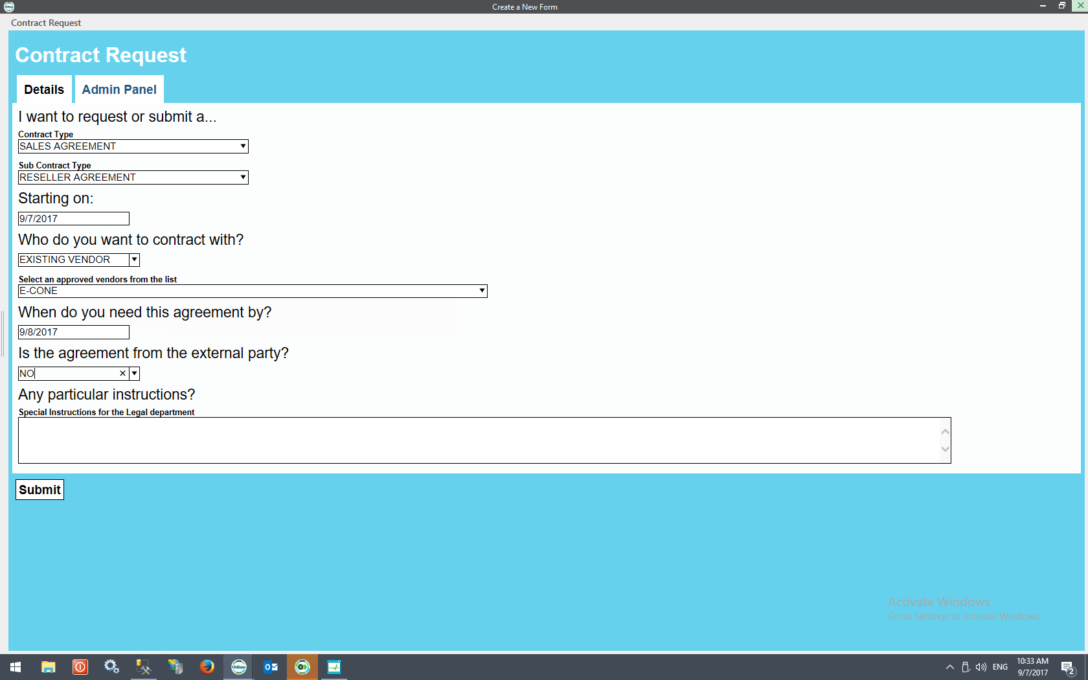
Starting the Contracting Process

Slide 22
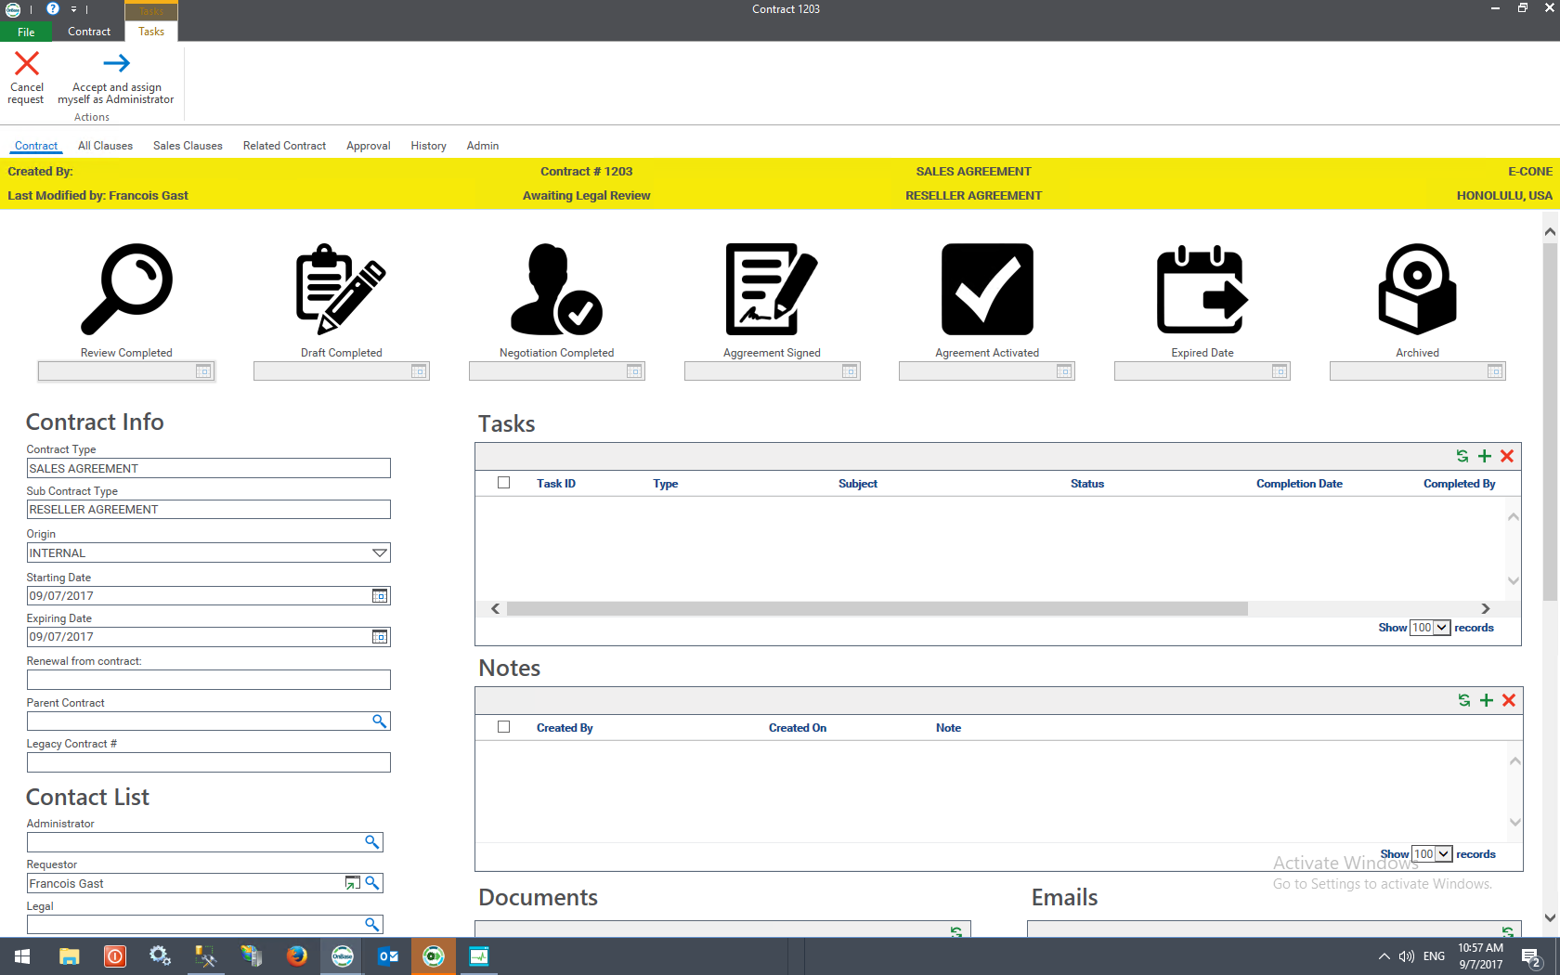
Jumping into the Contracting Process

Slide 23
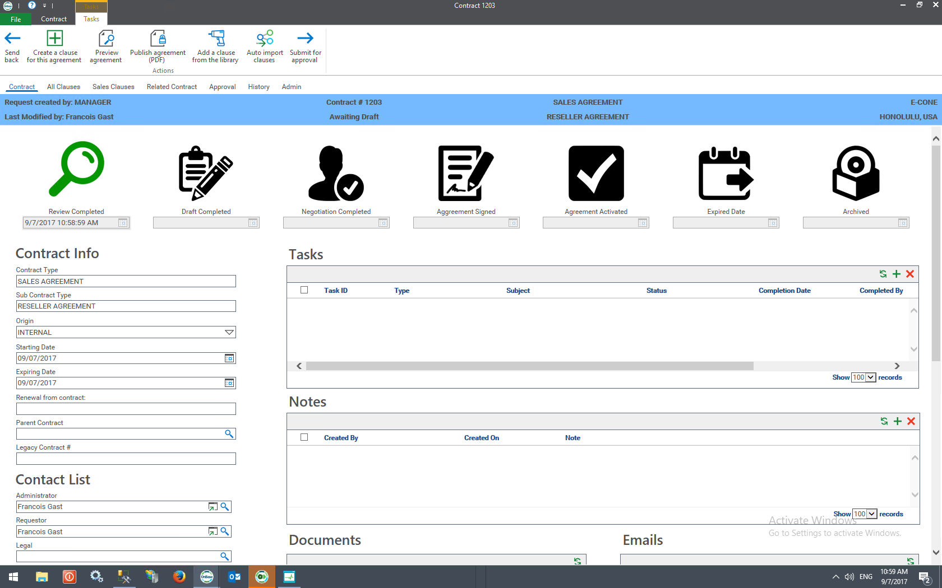
Working through Contracting

Slide 24
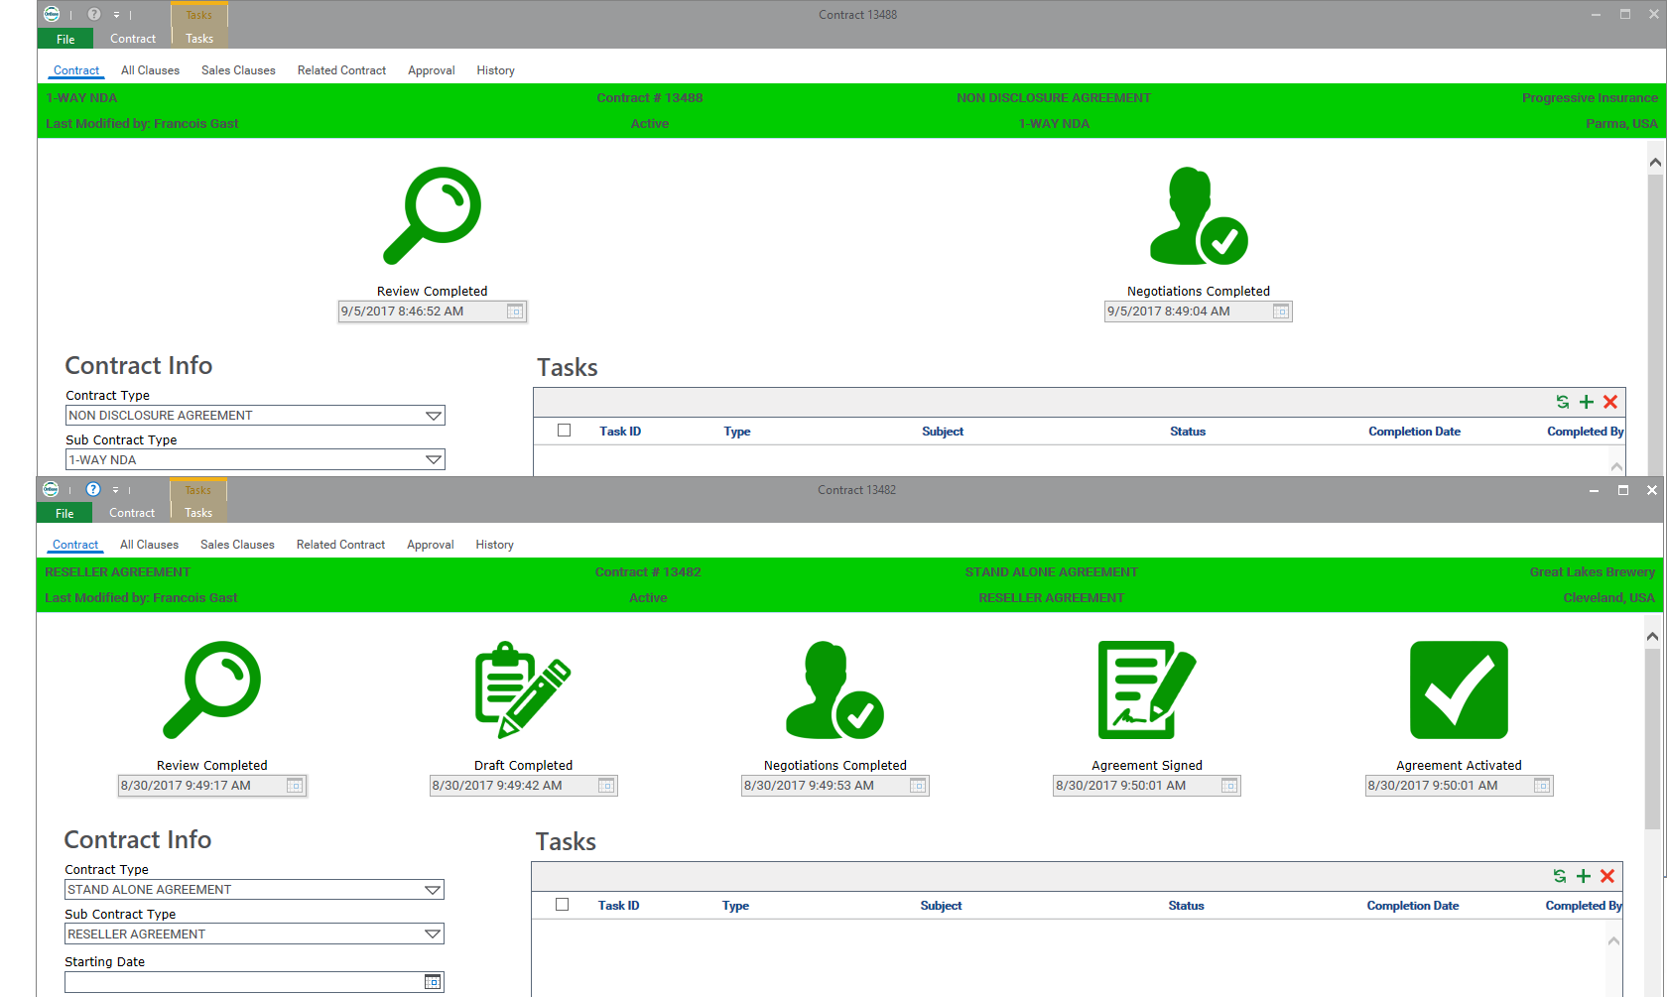
Process Path Reflects Different Rules

Slide 25
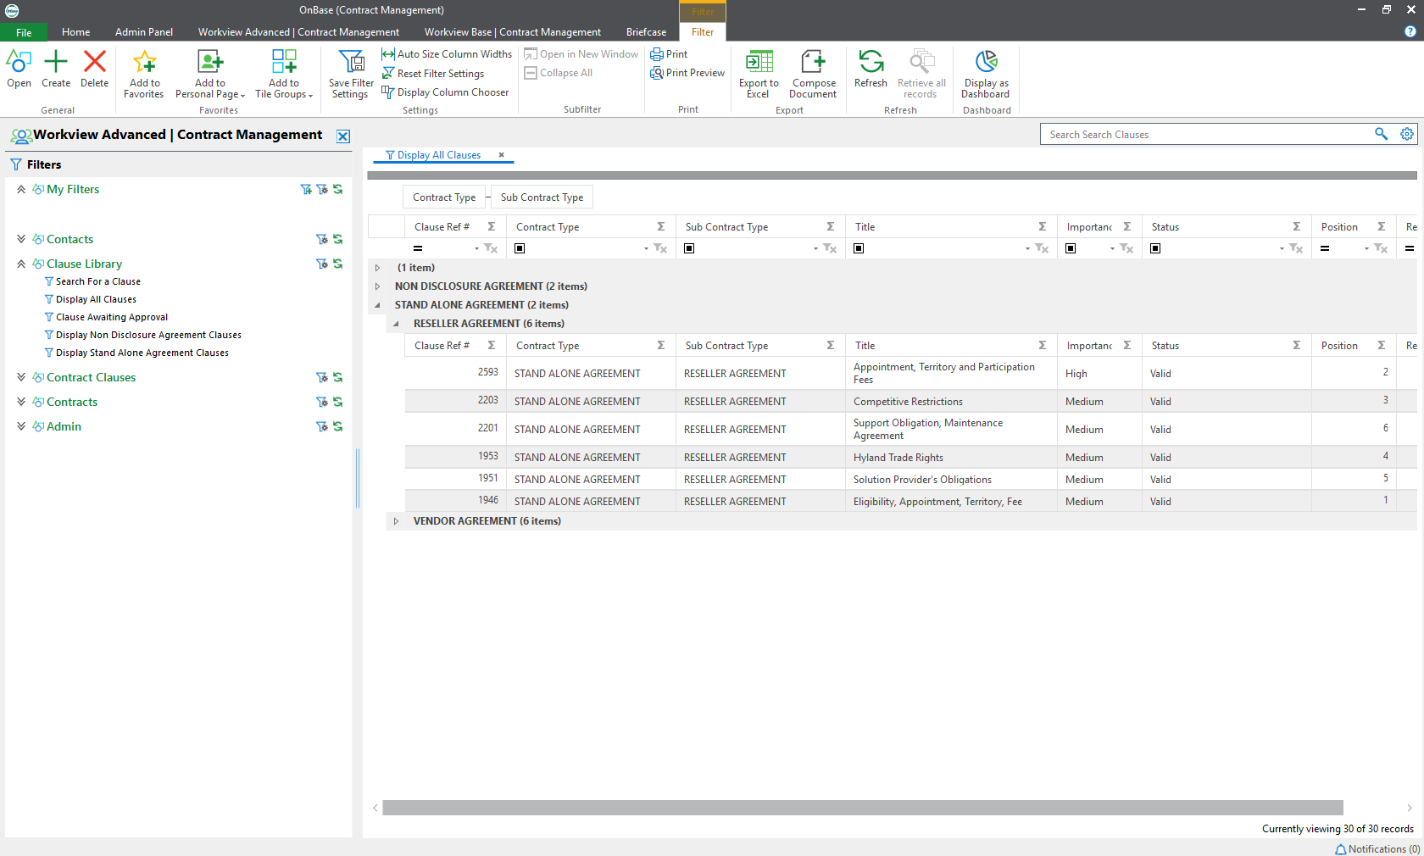
Managing Clauses

Slide 26
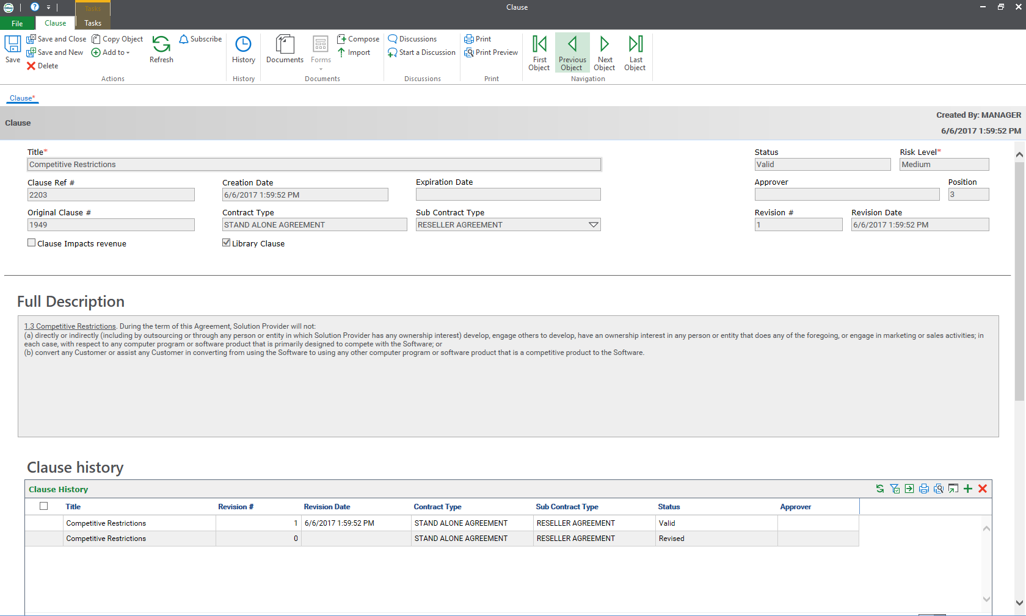
Powerful Data Management:
More than Just Content Storage

Slide 27
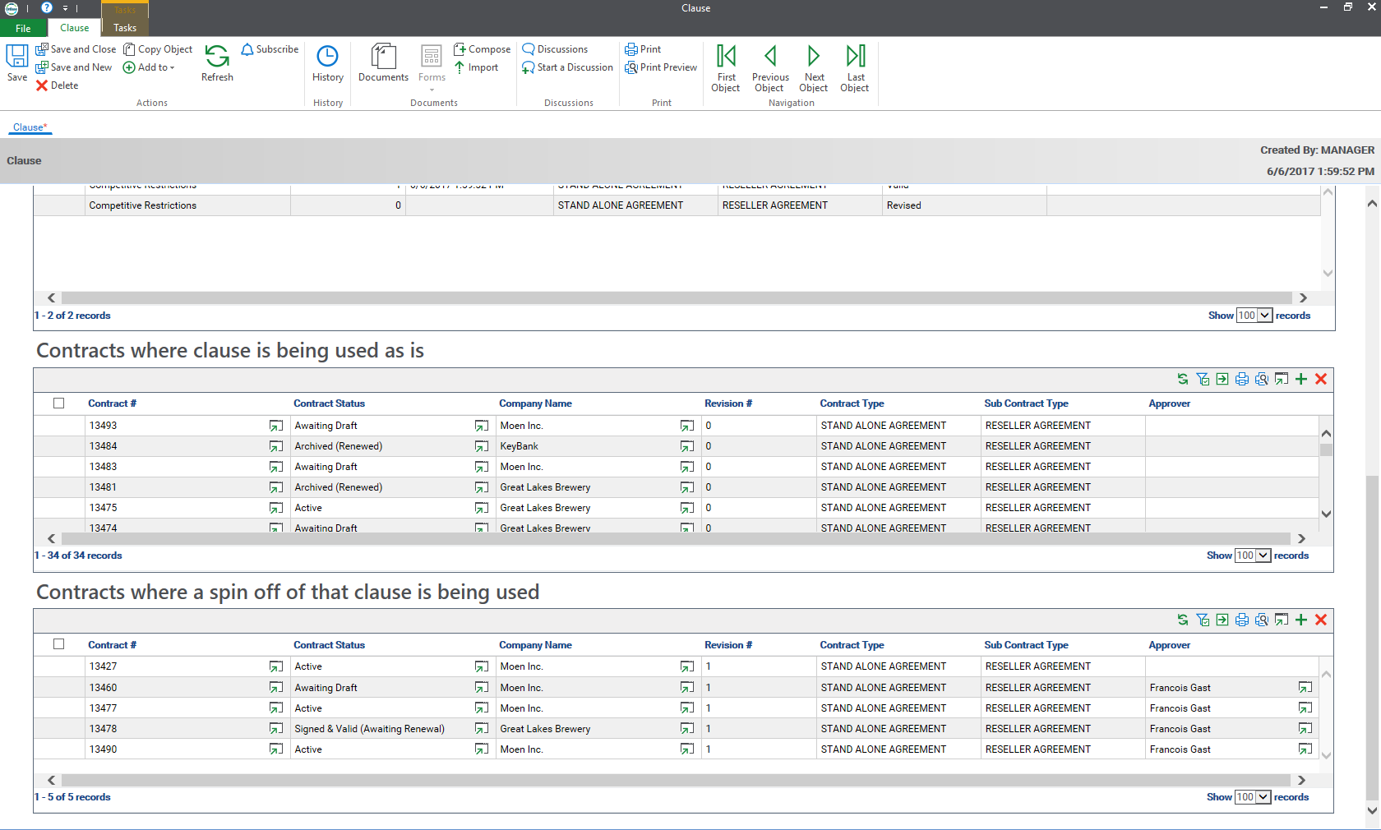

Slide 28
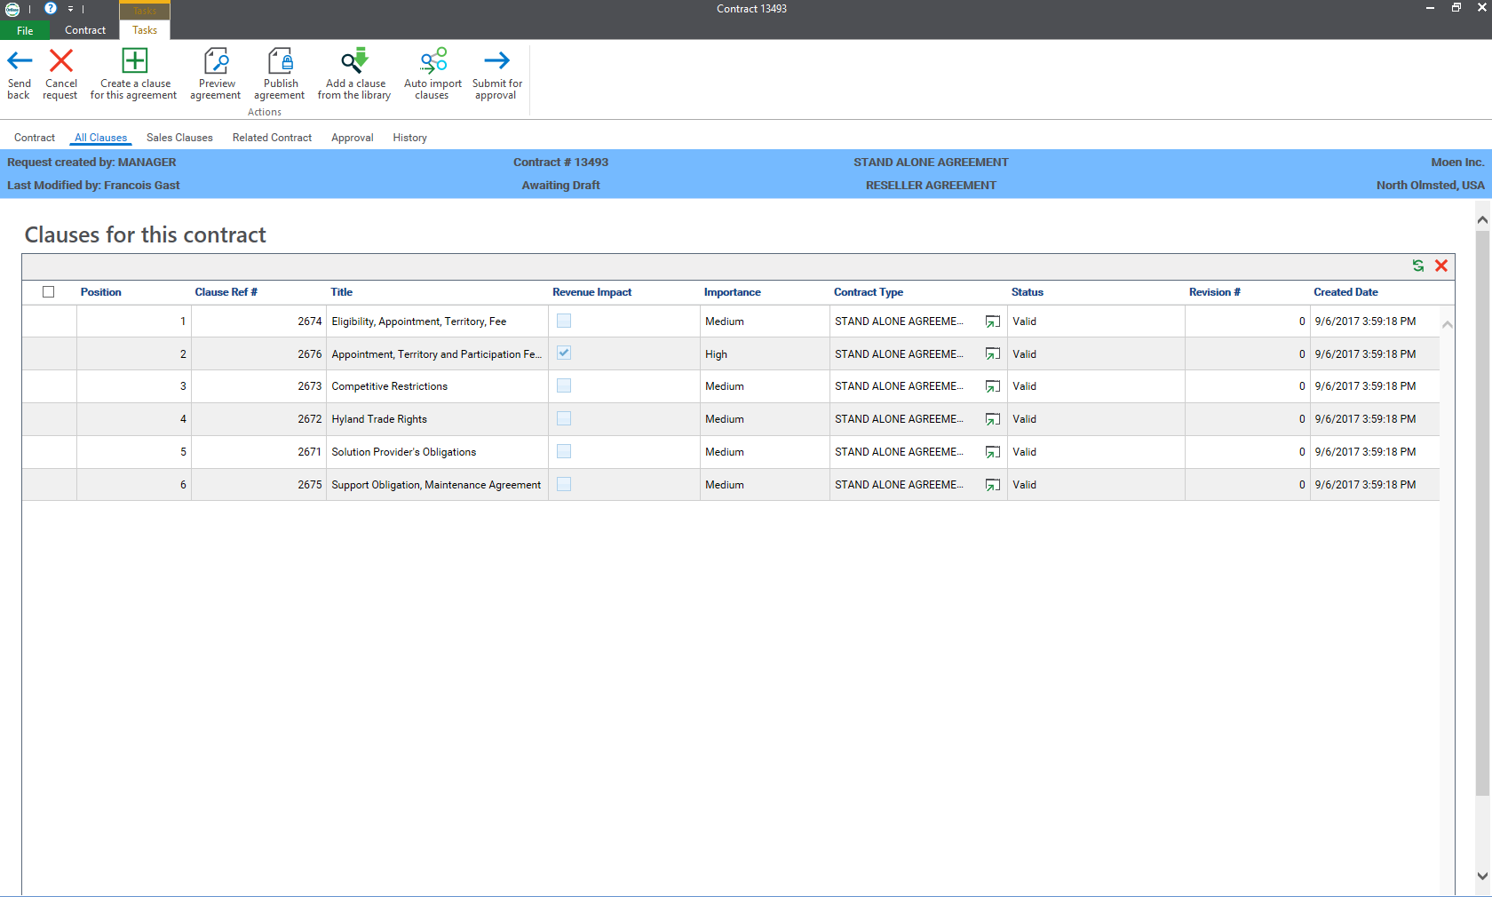
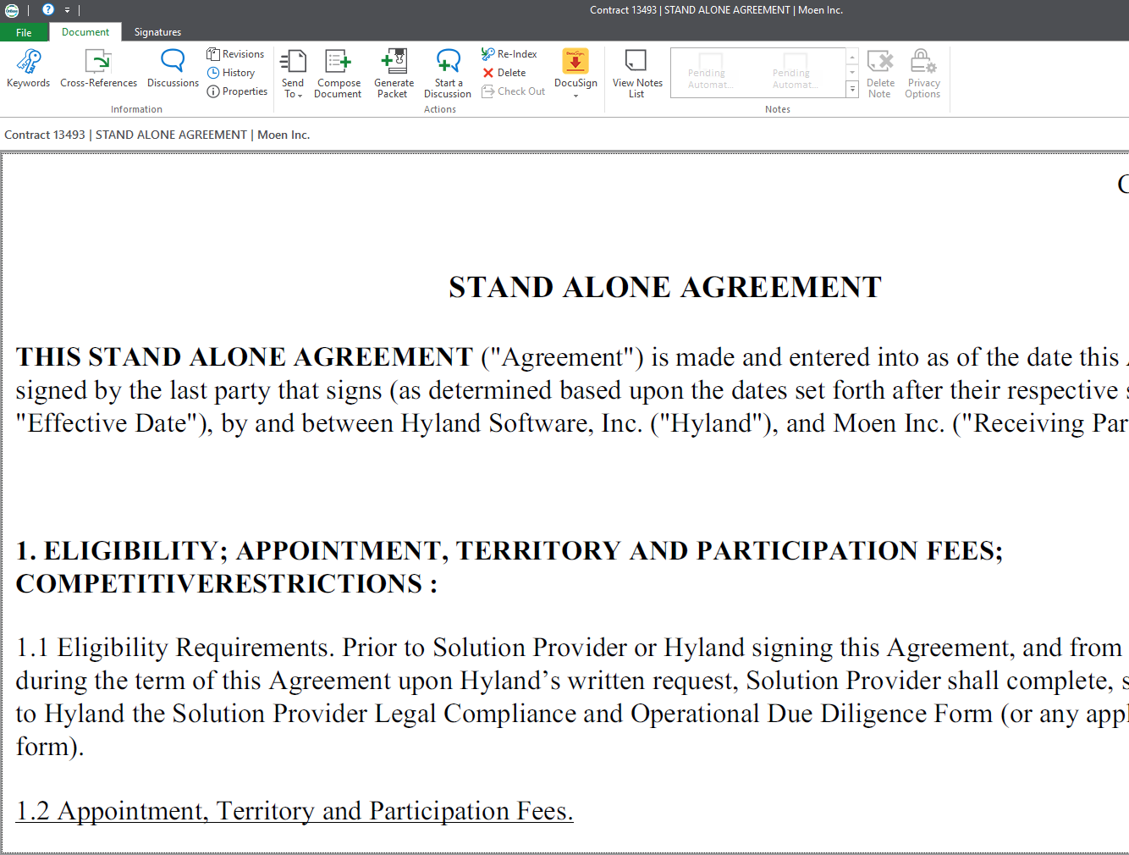
Document Generation Right from the Case

Slide 29
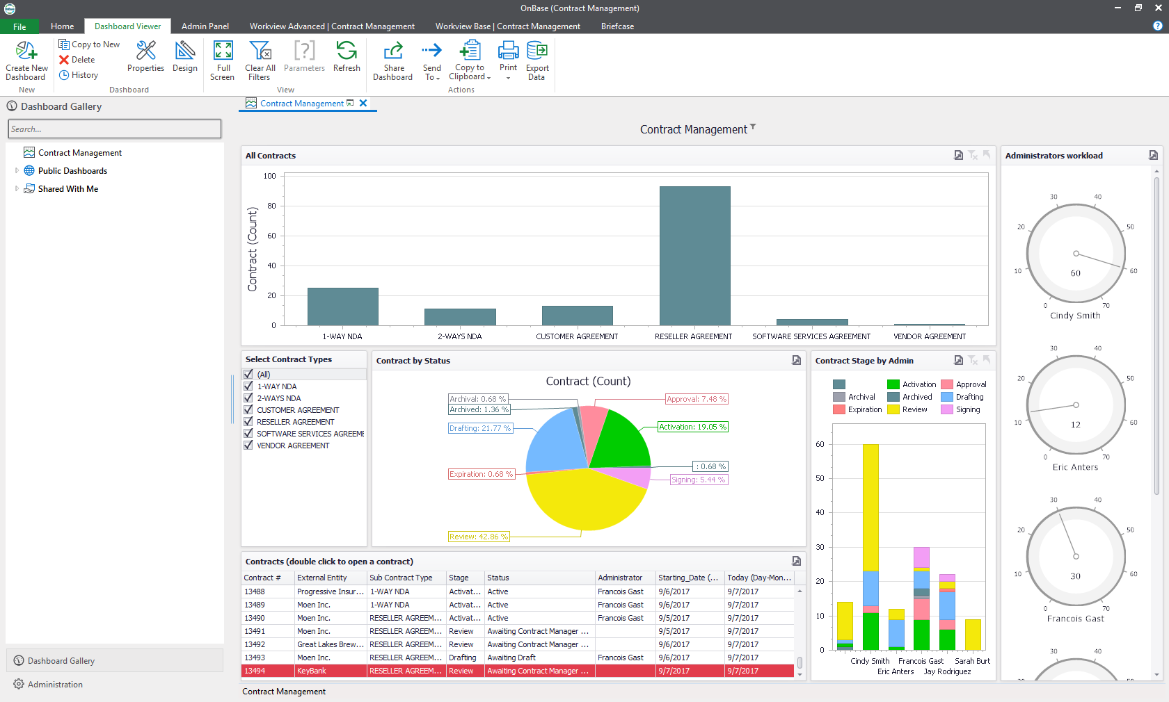
Process Reporting for Visibility

Slide 30
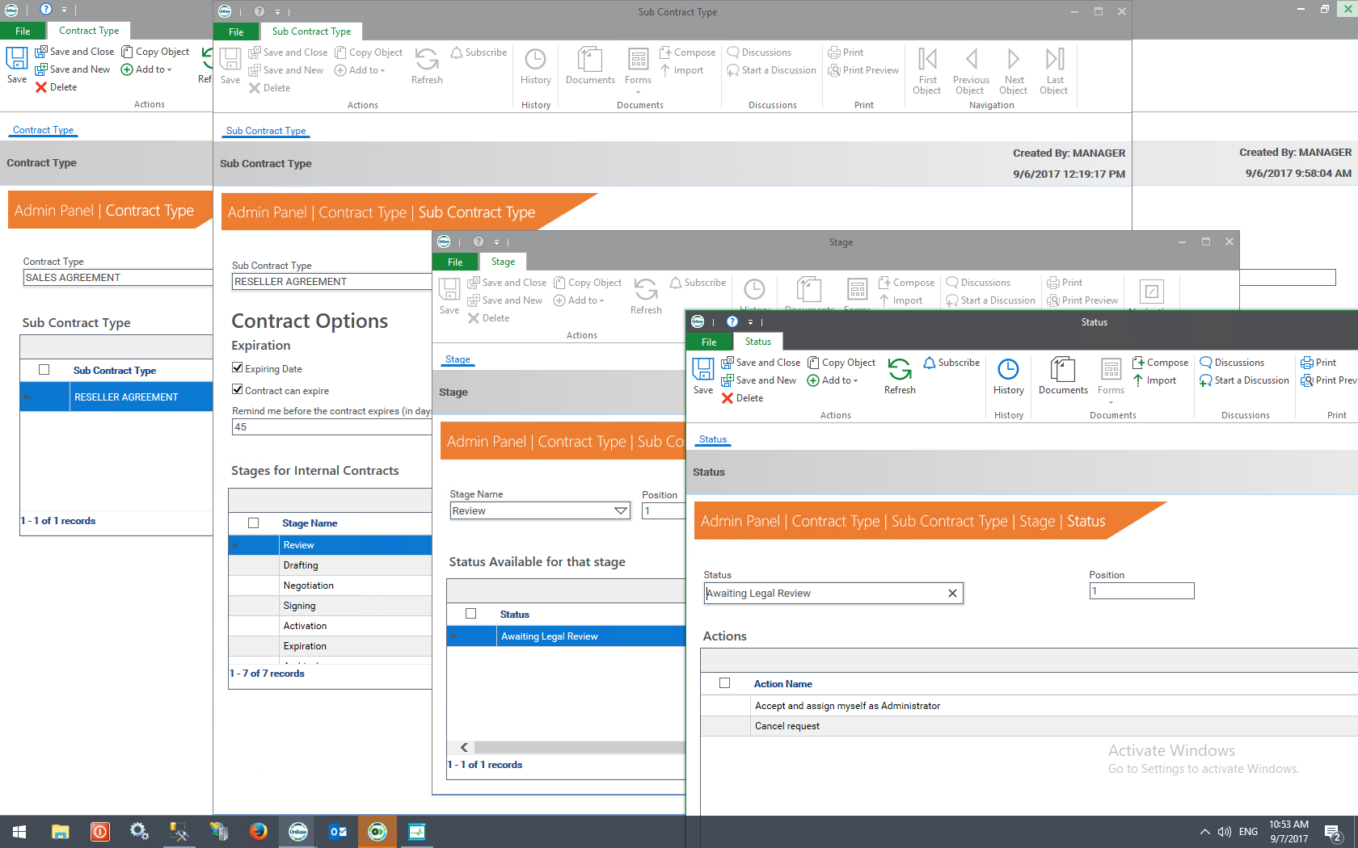
Administration Panel Manages the Process

Slide 32
Key Features

Slide 33
Making the Shell:
Creating Process Levels

Slide 34
Contract Type
Sub-Contract Type

Slide 35
Contract Type
Sub-Contract Type
Stage
Stages are the major events in the process that are visible as “Milestones”.

Slide 36
Contract Type
Sub-Contract Type
Stage
Step
Steps are the individual progress points in the process.
Task
Task

Slide 37
Contract Type
Sub-Contract Type
Stage
Step
Action
Actions are the things you can do at each Step.
Task
Task
Task

Slide 38
Contract Type
Sub-Contract Type
Stage
Step
Action
Tasks are the work assignments that ensures activities get done.
Task
Task
Task

Slide 40
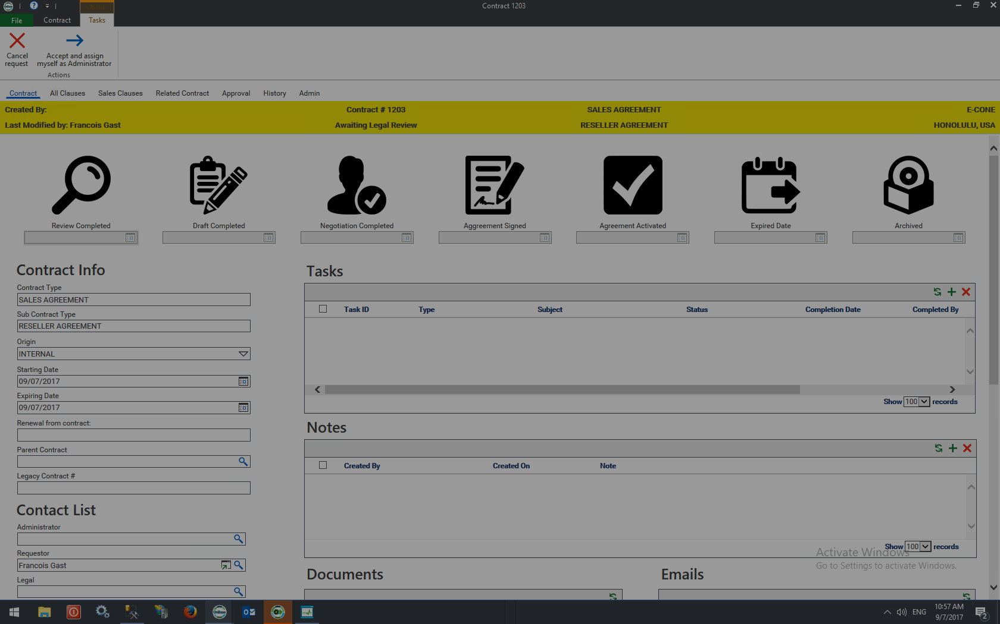
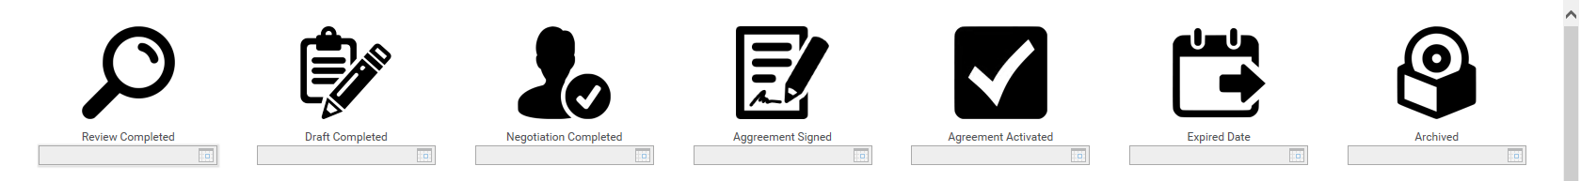

Slide 41
Separating the Logic Layer:
Administration Panel

Slide 43
OnBase CCM:
We Made a
Clause Library

Slide 45
In Closing

Slide 46
Q&A

Slide 47
Thanks for Joining Us!

